Slide 1
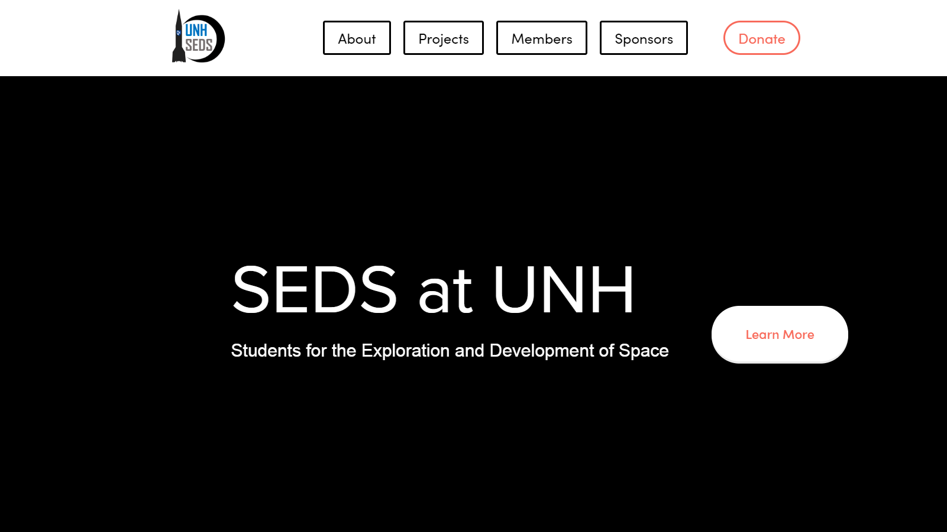
https://www.unhseds.org/

Slide 2
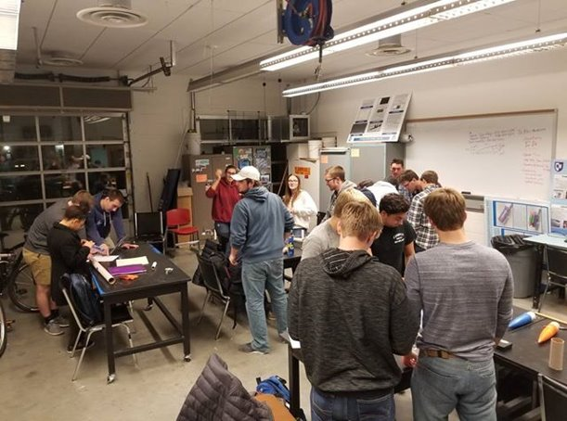
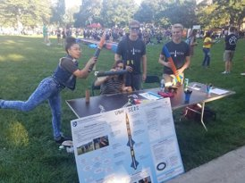
Who we are
UNH SEDS, or the University of New Hampshire Students for the Exploration and Development of Space, is an interdisciplinary engineering team motivated by our shared passion to further human knowledge in space exploration by combining our studies with meaningful projects.
Our team consists of over 30 members from all grades and fields of study. We participate in outreach to the greater seacoast area, research and competitions through the CEPS USRC and more.

Slide 3
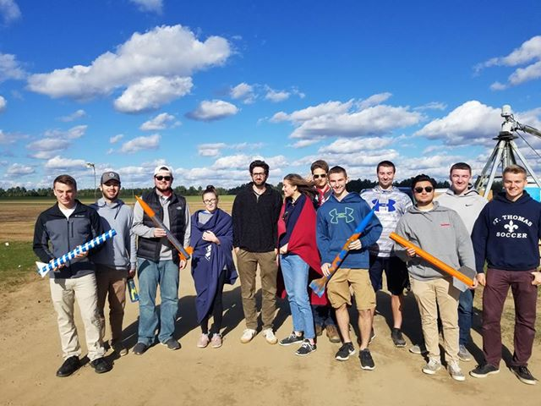
Our history
UNH SEDS has been around for 5 semesters. During that time we have completed 3 classes of rockets and are currently working on a hybrid engine rocket utilizing a liquid oxidizer and a solid fuel.
Experimental Class
Consisting of 2 Rockets.
Aether Class.
Consisting of 7 Rockets.
USRC Carbon Fiber Class.
Consisting of 1 Rocket.
Hybrid Engine Rocket.
Current production.
Compilation Video [Next Slide]

Slide 4
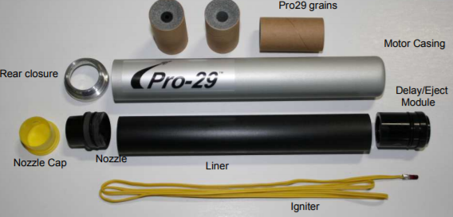
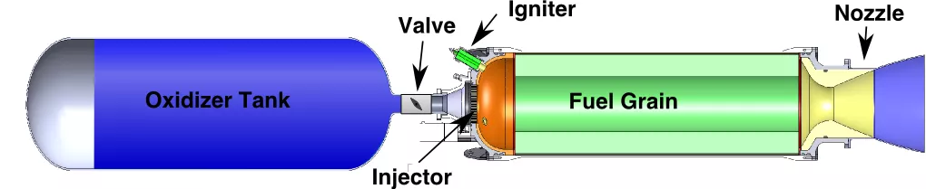
Previous rocket engines
Hybrid Rocket Engine
Purchasable at,
https://www.apogeerockets.com/Rocket_Motors/Cesaroni_Propellant_Kits

Slide 5
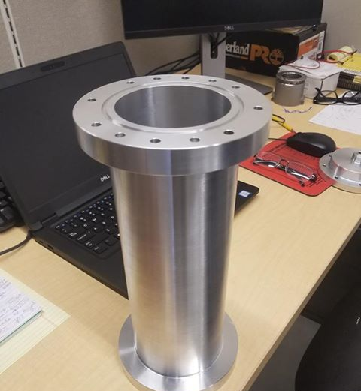
Current Operations
Project Runaway started in September 2018 with the research and development stages. In November 2018, we began the manufacturing and assembly stage which is nearly finished, with an estimated end date of February 1st.

Slide 6
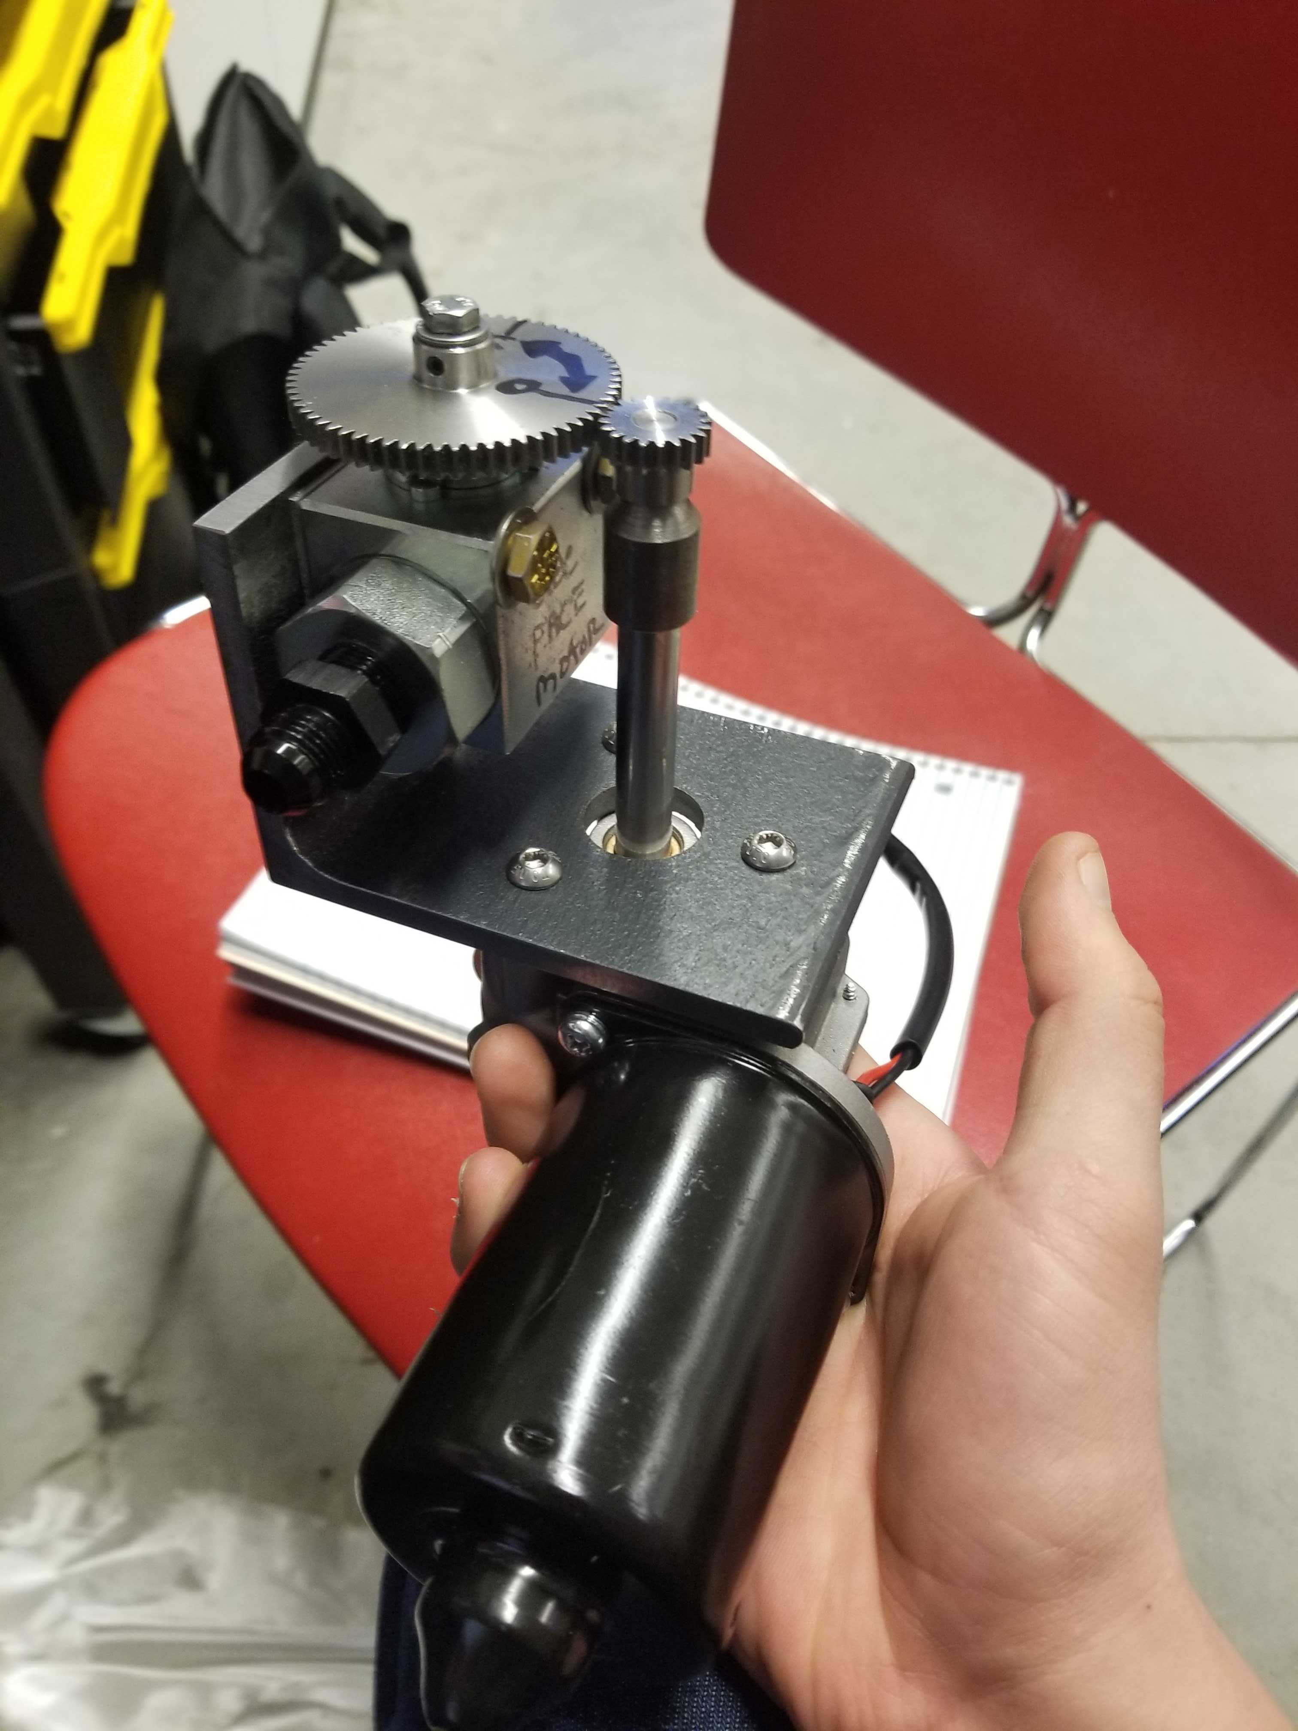
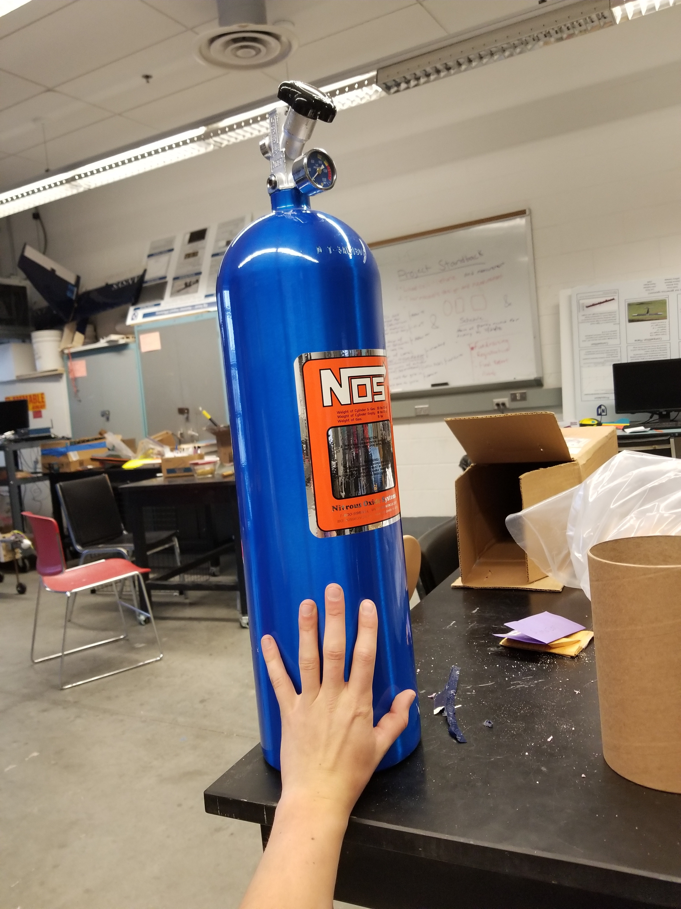
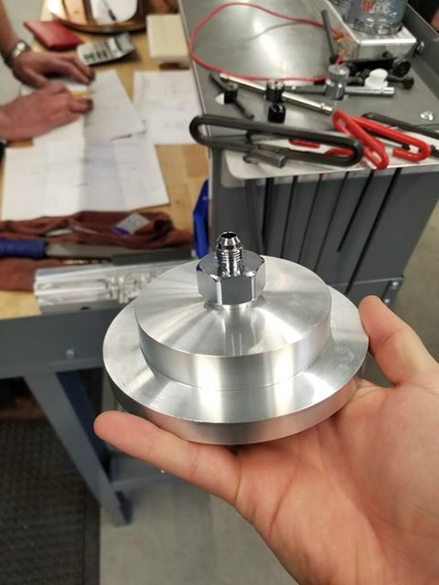

Slide 7
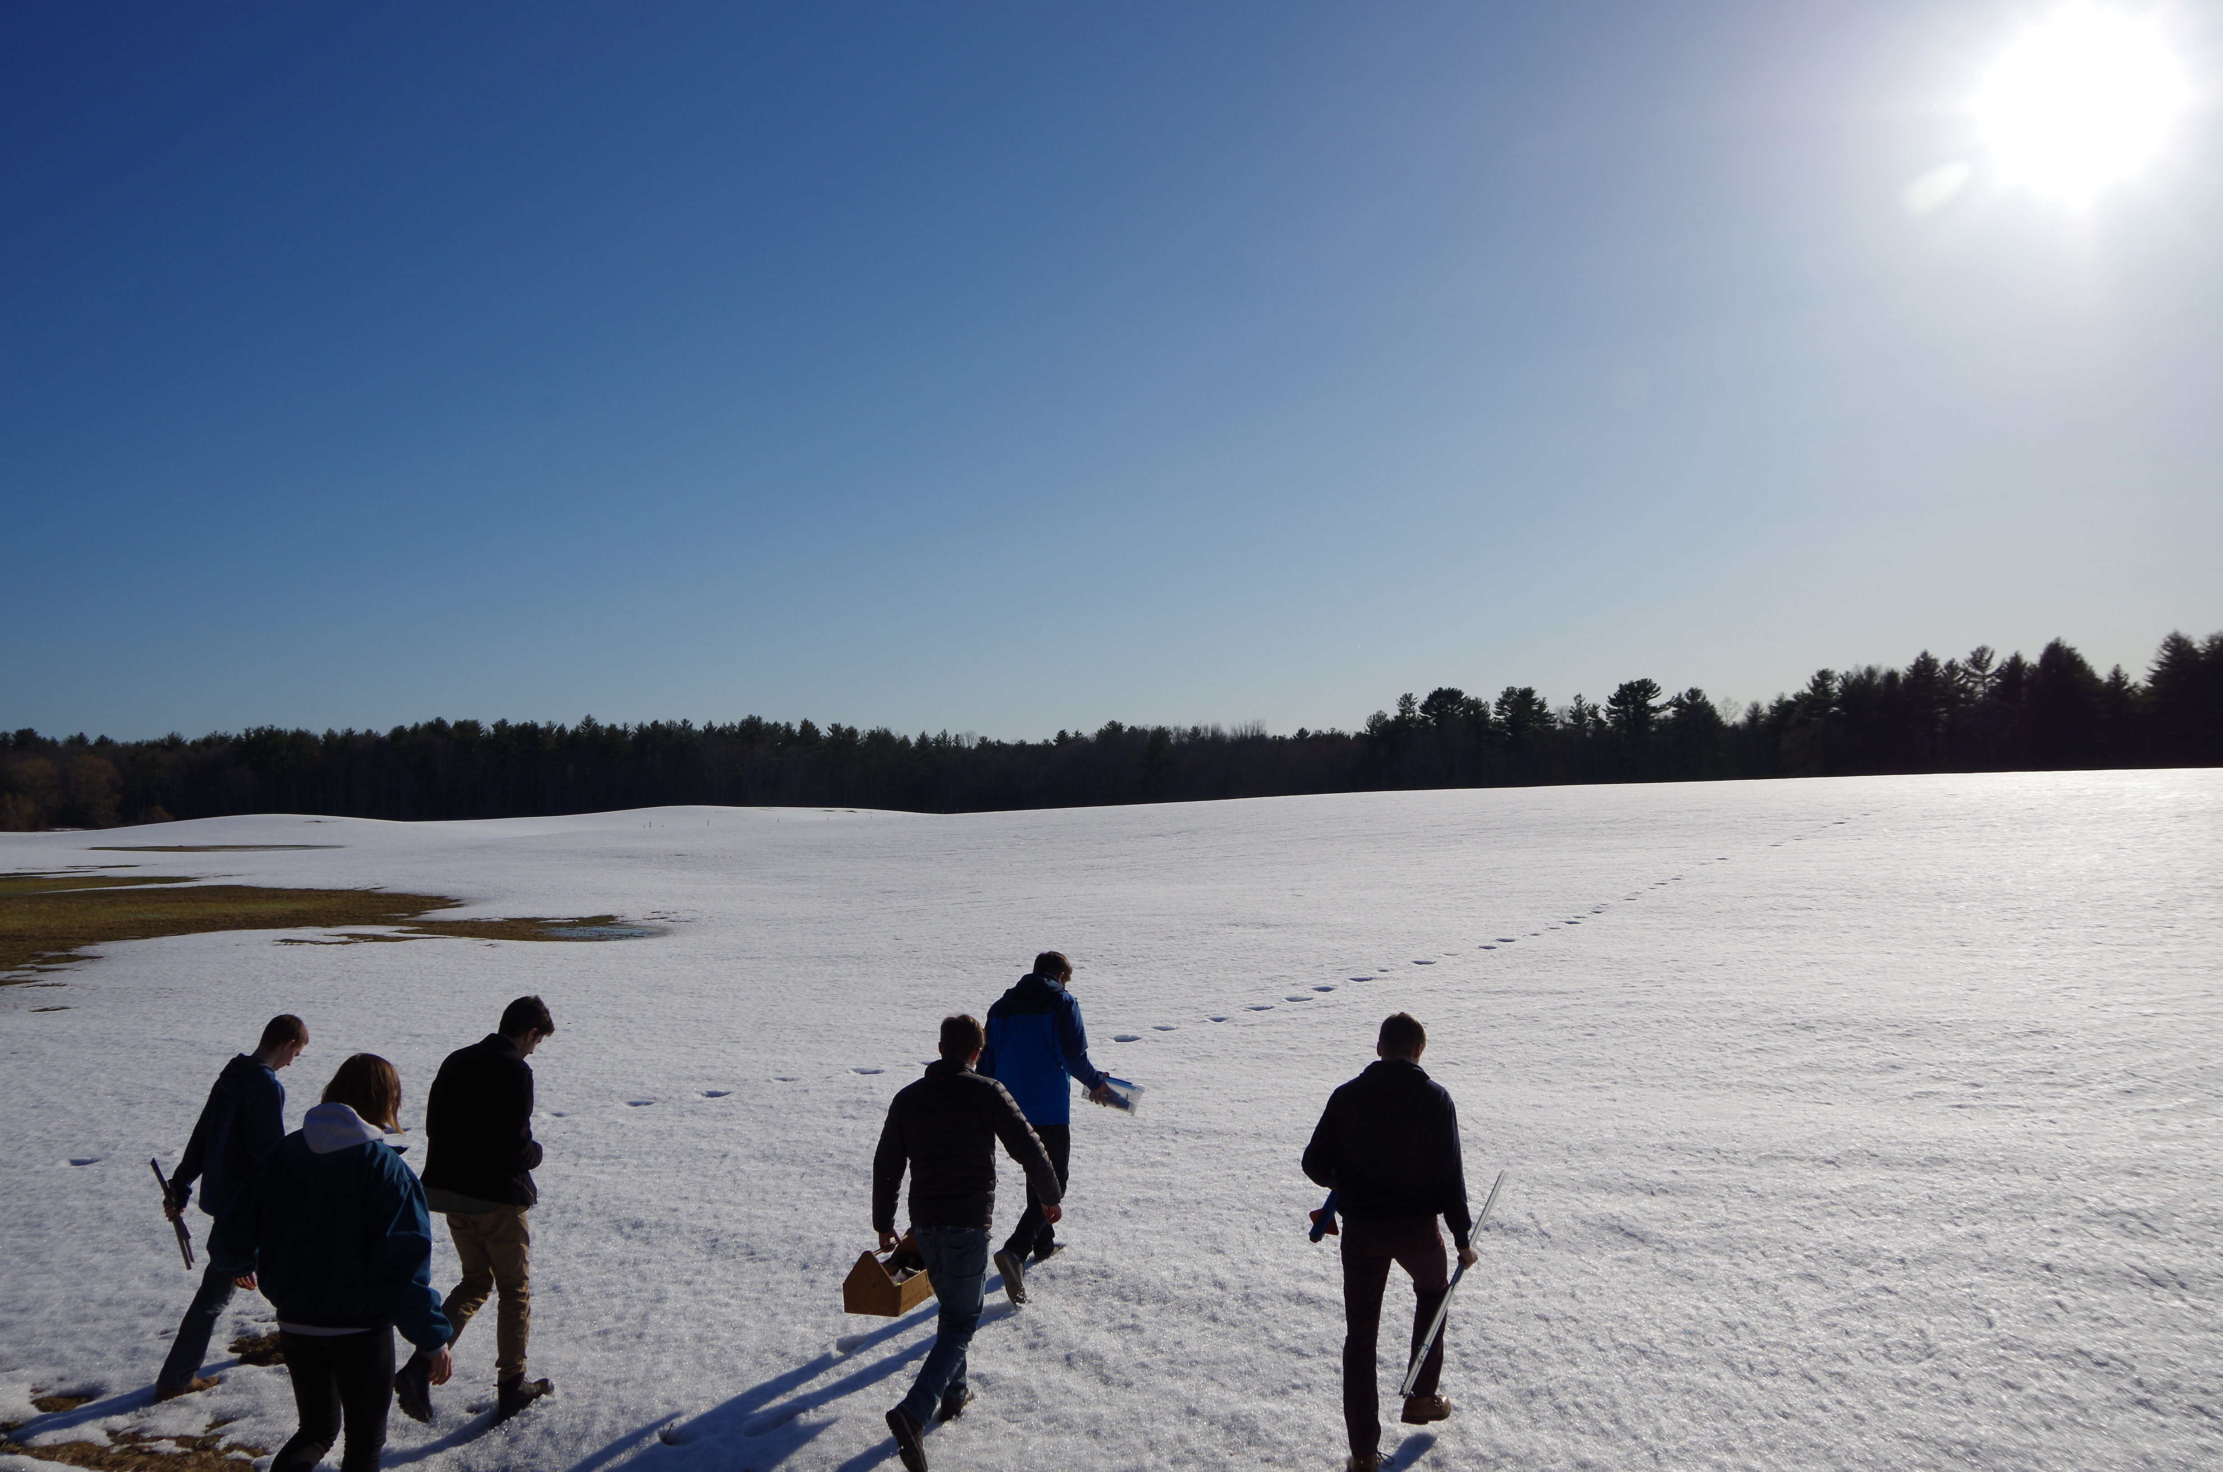
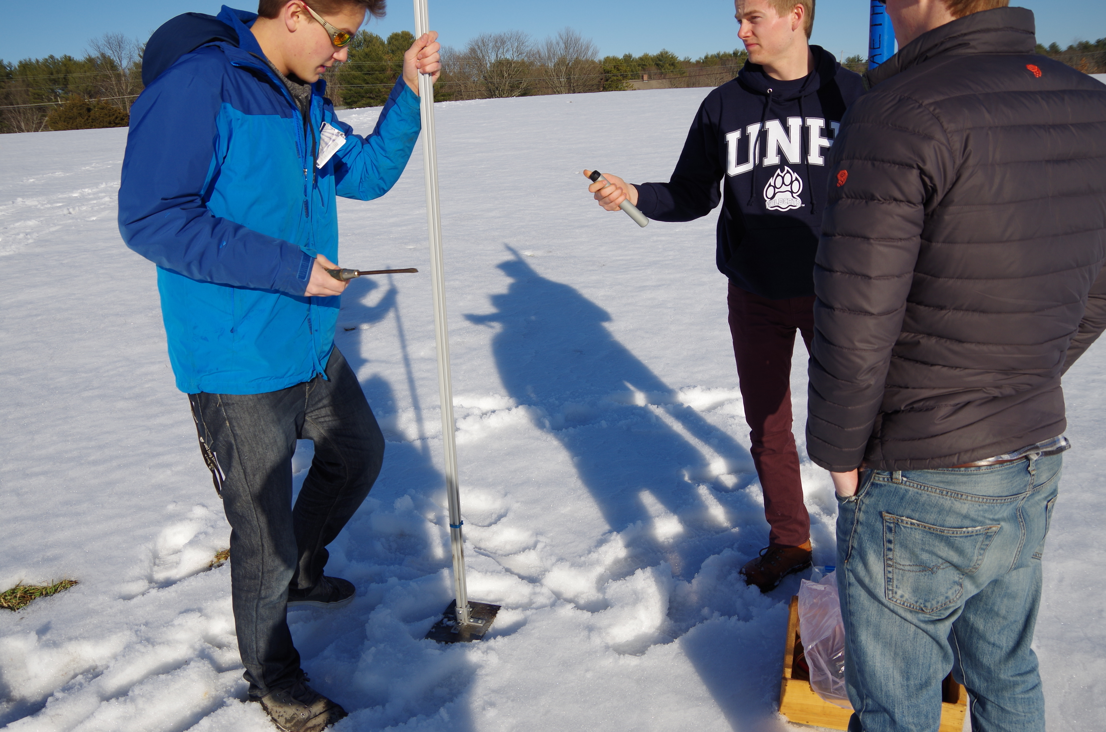
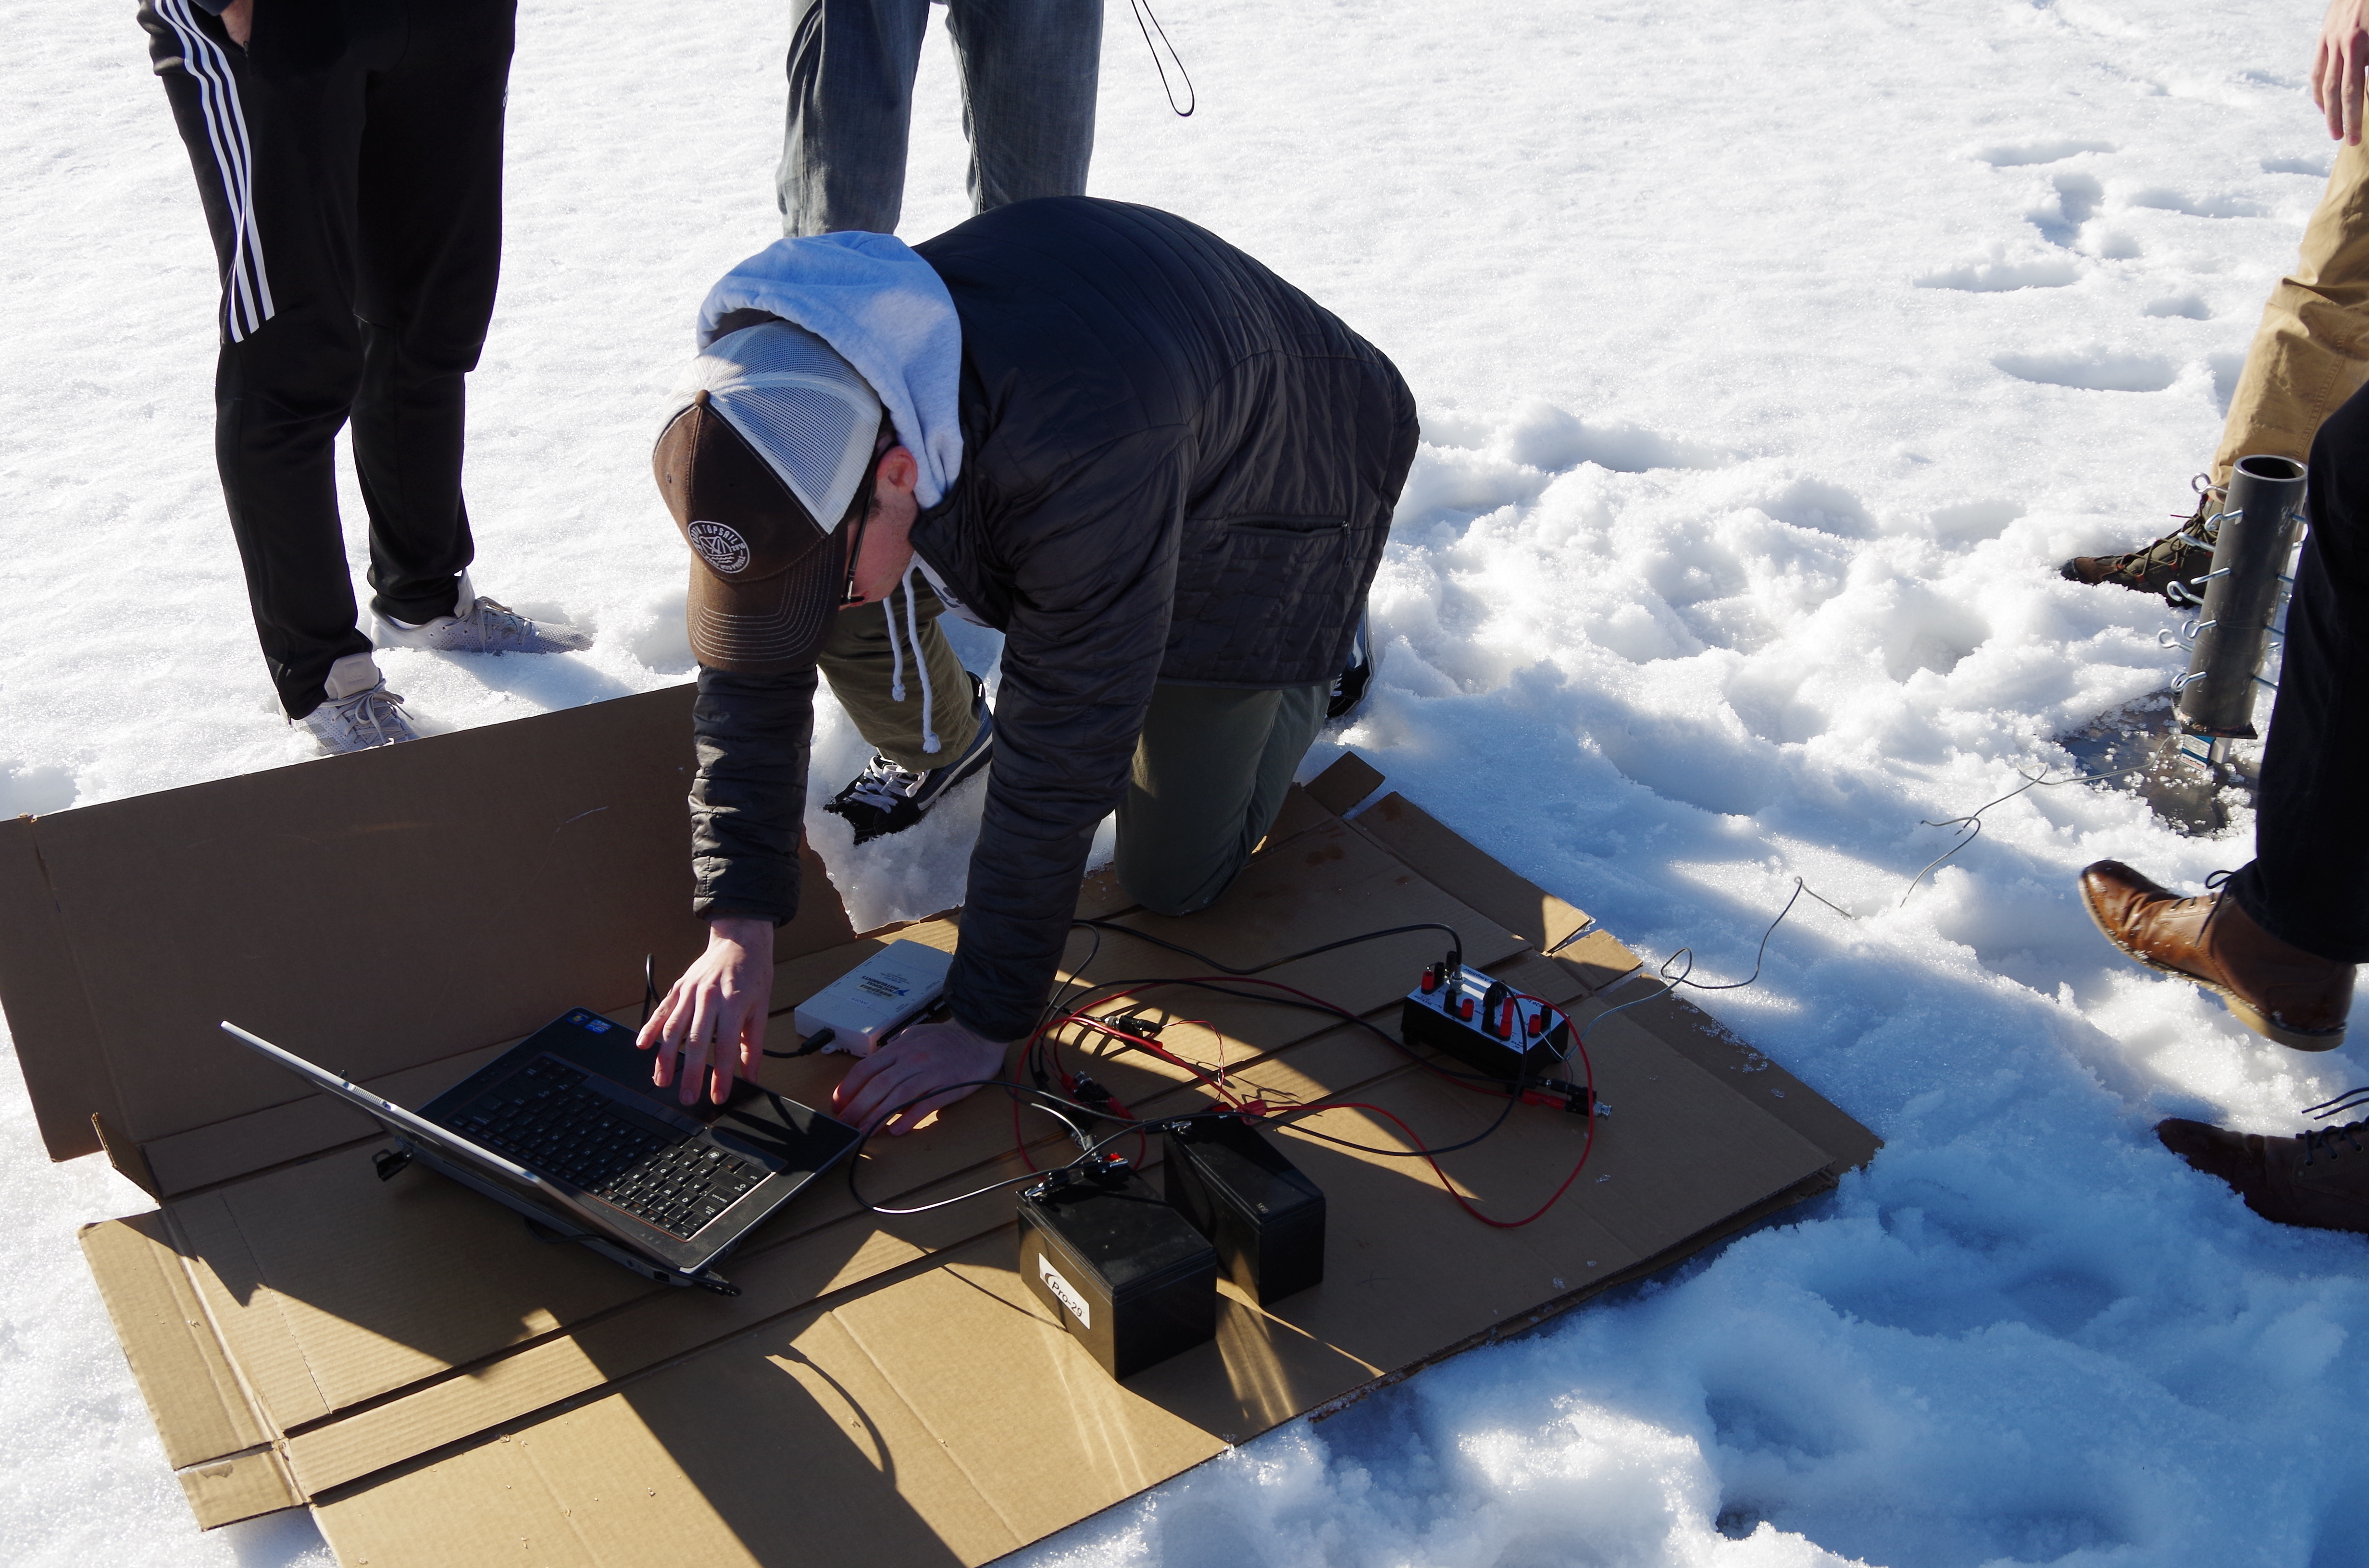
The Goal
Rocket launches are the culmination of hundreds of hours of student-lead engineering work. They are exciting, no matter the outcome. With the progression of more complex, and consequently, more powerful rockets, actions must be taken to keep all spectators completely safe.

Slide 8
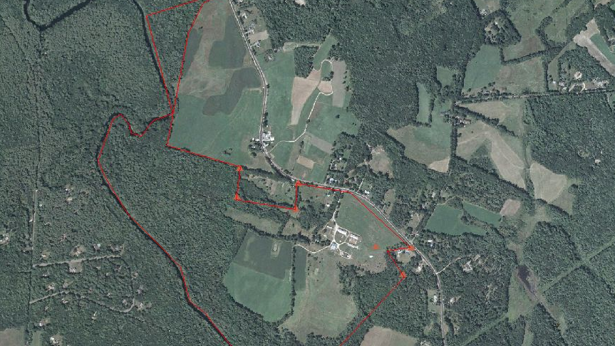
Burley-Demeritt Farm

Slide 9
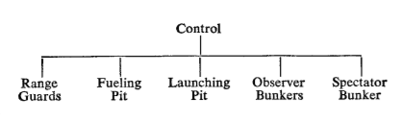
Making Future Operations Safest

Slide 10
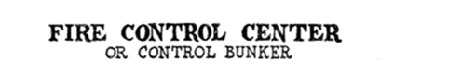
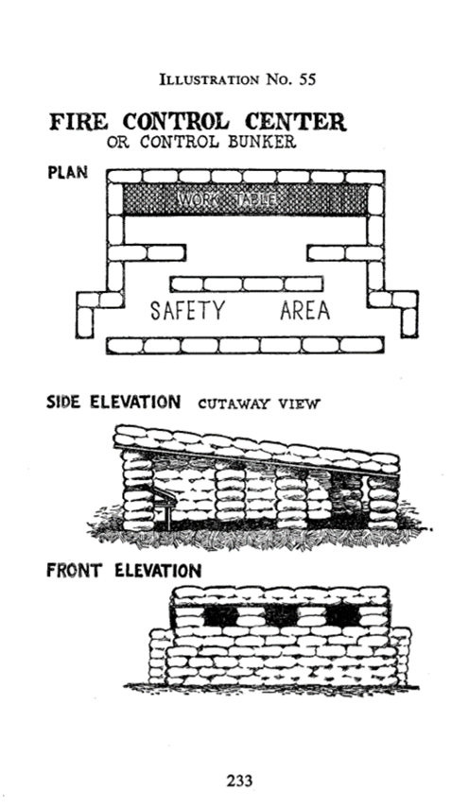


Slide 11
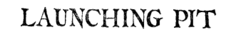
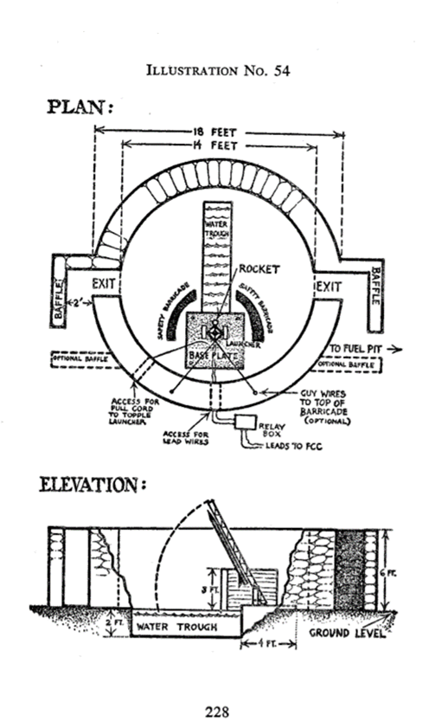

Slide 12

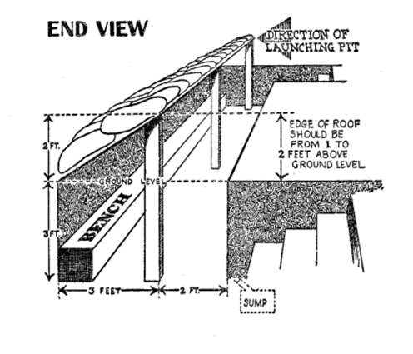

Slide 13
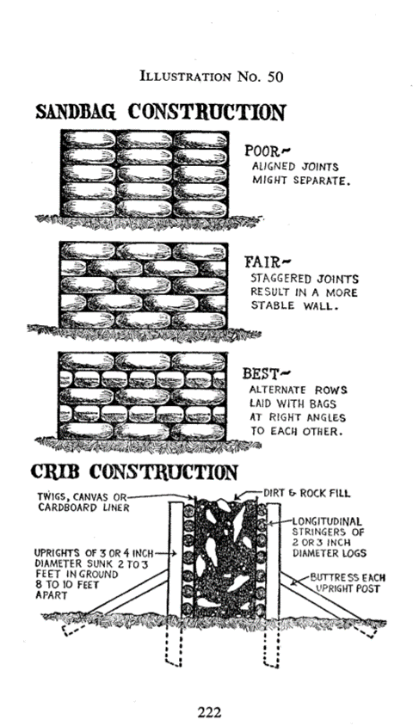


Slide 14
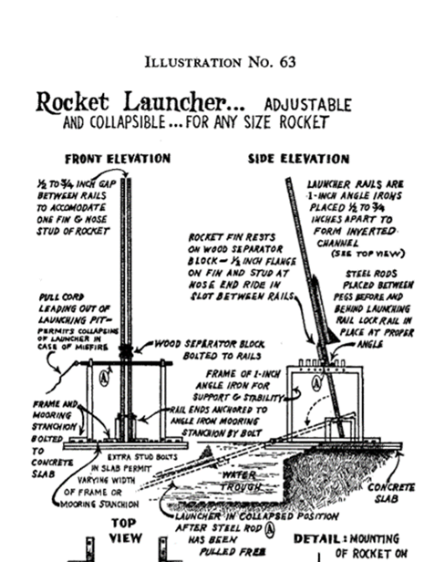
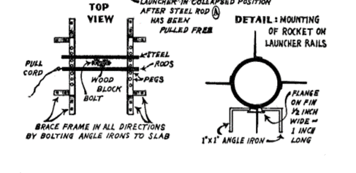

Slide 15


Next Steps
Ideal Field Selection
Largest UNH-owned field available
Approval for the building of semi-permanent safety structures
Obtain UNH-sourced funding
CEPS Funding
SAFC Funding

Slide 16
Questions, Comments and Concerns?

